Slide 1

Jhenaidah Sadar Hospital model development by local initiatives
Dr. Md.Emdadul Haque
National Consultant
C-J Model Replication Committee

Slide 2
Comparative data of health facilities of different country of the world
SL NO | Country | Per capita health Expenditure per year by Govt. ($) | Doctors per 10000 Population | Nurse per 10000 Population | Beds per 10000 population | Out of pocket expenditure
01 | USA | 10246 | 29 | 119 | 29 | 11.08
02 | UK | 3860 | 28 | 82 | 25 | 14.79
03 | Malaysia | 384 | 15 | 35 | 19 | 36.67
04 | Sri Lanka | 159 | 10 | 21 | 41 | 38.43
05 | India | 69 | 7. | 17 | 5.3 | 65.06
06 | Nepal | 48 | 7.5 | 31 | - | 60.41
07 | Pakistan | 45 | 9.8 | 7 | 8 | 66.49
08 | Bangladesh | 37 | 5.3 | 4 | 8 | 67
World Bank 2018

Slide 3
Challenges of the hospital in 2012
Insecure hospital environment.
Performance of all activities was very low.
Very limited support staff.
3 doctors including RMO was suspended.
Non-gov. staff. demanding money from the patients.
Waste management system was poor.
Monitoring meeting was not performed regularly

Slide 4
Characteristics of Jhenaidah Sadar Hospital Model-1
Successful leadership in health management.
Personal and group skills in health care.
Community engaged health management.
Optimum use of government resources.
Effective relation with local administration and with other government organizations.
Improvement of security by community engagement.
Improved maternal health care activities.
Improved child health care activities.
Ensuring corner-based health care.

Slide 5
Characteristics of Jhenaidah Sadar Hospital Model-2
Woman and Baby Friendly Hospital.
Birth and death recording, progress assessment and develop accountability by collecting information on all health indicators.
Improving healthcare by unit management.
Health awareness by health education.
Cleanliness (Waste management) and beautification of the facility and premises.
Provision of safe blood transfusion for emergency needs
Zero tolerance against corruption.
Implementation of the 5S KAIZEN-TQM for the improvement of health quality.

Slide 6

Sadar Hospital, Jhenaidah
Bed Occupancy Rate from 1998 to 2019

Slide 7


Emergency + Out Door & Indoor Service 1998 to 2019
Emergency + Outdoor visit, Indoor (admission)

Slide 8
Operation Service (Major) 2011 to 2019
Sadar Hosital, Jhenaidah

Slide 9

Sadar Hospital, Jhenaidah
Admitted Under 5 children in indoor from 2014 to 2019

Slide 10
Total ANC and Delivery in Jhenaidah District Hospital 2011-2019

Slide 11
Comparative Data of Delivery of best performing EOC center of Khulna Division in 2011,2017,2019
 | Hospital | 2011 |  | 2017 |  | 2019
SL No | Name of institute | C. Section | Total | C. Section | Total | C. Section | Total
01 | Khulna Meidcal College | 1356 | 3013 | 1228 | 2683 | 1828 | *4362
02 | Jashore Meidcal College | 1498 | 2852 | 1778 | 2967 | 1503 | 3078
03 | Kustia Meidcal College | 915 | 2677 | 1030 | 2781 | 1616 | 3674
04 | 100 bed, Jhenaidah sadar | 430 | 2375 | 1143 | *2997 | 1019 | 2753
05 | Chowgacha UHC | 1007 | *4413 | 759 | 2922 | 854 | 2957

Slide 12
Comparative data of revenue income (in Taka) from 2015 to 2019
Sadar Hospital, Jhenaidah

Slide 13
Community Support System in Sadar Hospital
Staff : 53
  Cleaner: 20
  Aya /Word boy: 21
  Security guard: 6
  Volunteer: 3
  Trolley man: 3
Generator.
Intercom.
Biochemical analyzer.
Reformation of medicine, surgery, pediatric word.
Boundary wall repair.
Dining space for patients.
Donors:
MP.
Mayor.
Zahedee Foundation.
Doctors.
Other donors
Retd. Secretary .

Slide 14


Visit to Shatkhira District Hospital and Introduction of TQM activities
A team of Jhenaidah sadar hospital visited to Shatkhira sadar hospital in 2014
A meeting was held in Shatkhira sadar conference room

Slide 15


5S KAIZEN-TQM Program Started in Jhenaidah Sadar Hospital in 2014
TQM program started in Jhenaidah Sadar Hospital
A meeting of QIC was held in Jhenaidah Sadar Hospital Conference room

Slide 16




Changes in EOC Ward
Before
After
Before
After

Slide 17








Changes in Surgery & Pediatric Word

Slide 18




Waste Management & Campus Protection
Before
After
Before
After

Slide 19




Use of direction sign, labeling of rooms, clean latrine and waste segregation
Use of direction sign
Labeling of rooms
waist segregation
Clean latrine

Slide 20




Use of color code, alignment of picture & continuous big cleaning day
Color code
Color code
Alignment of pictures

Slide 21


Innovative activities of Jhenaidah Sadar Hospital - 1
Creation of awareness towards Health Education for the patients and their attendances.
Motivation of the community, the teachers, reporters, social workers, cultural activists and donors of the hospital .

Slide 22




Innovative activities community supported manpower - 2
Trolley man
Cleaner
Guard
Nursing aid

Slide 23




Innovative activities of Jhenaidah Sadar Hospital - 3
Repaired boundary wall
Campus beautification
Cycle stand
Recovery of hospital land

Slide 24




Innovative activities of Jhenaidah Sadar Hospital - 4
Digitalization of patient profile
Organized pharmacy
Improved conference room
Visitor Restriction

Slide 25


Innovative activities of Jhenaidah Sadar Hospital - 5
Reception room provided by community support
ECG facility in enemrgency department

Slide 26



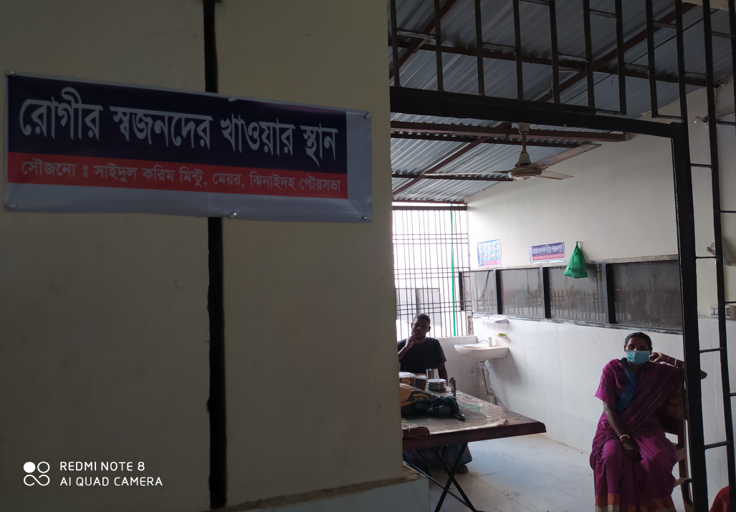
Innovative activities of Jhenaidah Sadar Hospital - 6
Intercom system by community sup.
Generator by community sup.
Dining facility by community sup.
Extension of hospital mosque

Slide 27




Involvement of MP, District Administrator & Mayor in Sadar Hospital
Perticipation of Previous MP in beautification
Perticipation of Previous Zilla parishad chairman
A big cleaning day on 17 March
Crowd control by scout

Slide 28
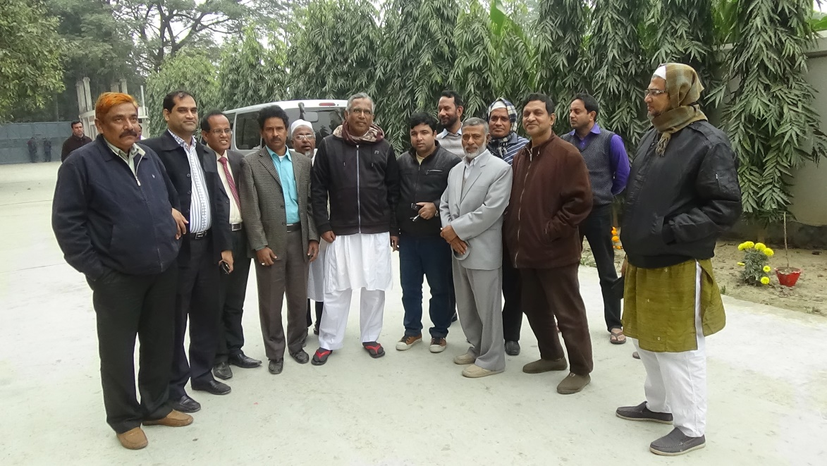
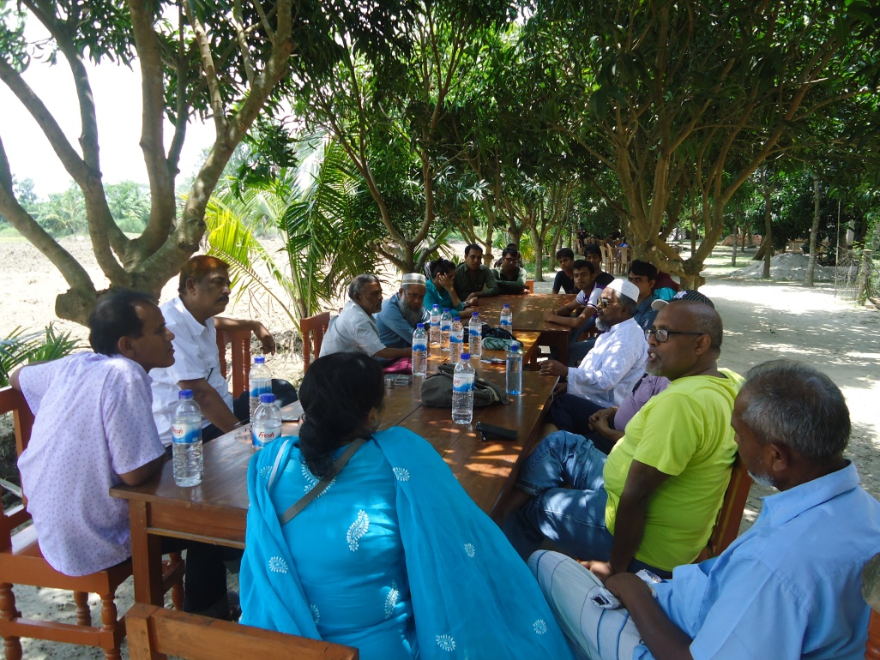
Learning visit of community leaders to Chowgacha and Nuhata
Jhenidah team visited Chowgacha
Jhenidah team visited Nuhata, Magura.

Slide 29




Involvement of district high officials in hospital activities
Blood donation camp by district judge
Hospital visit by DC
Hospital visit by SP
Manobota blood donor group opened by CS

Slide 30




Internal Monitoring System
Meting of health improvement committee
Meting of community support group committee
QIC meeting
Monthly meeting schedule

Slide 31
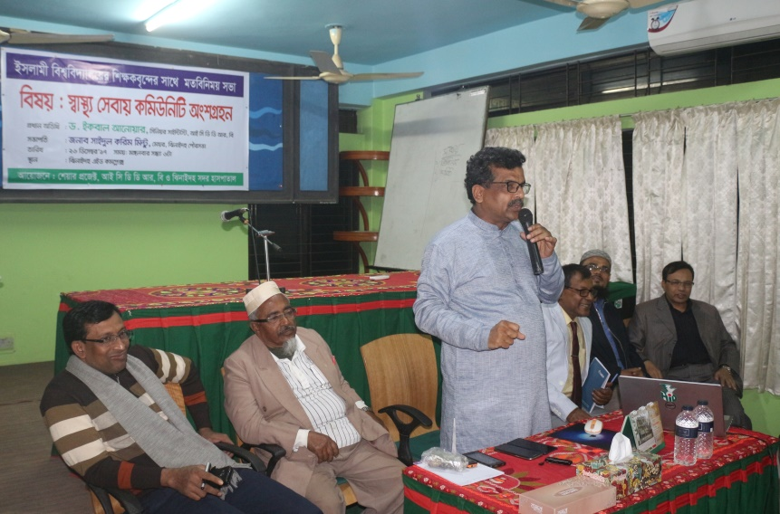
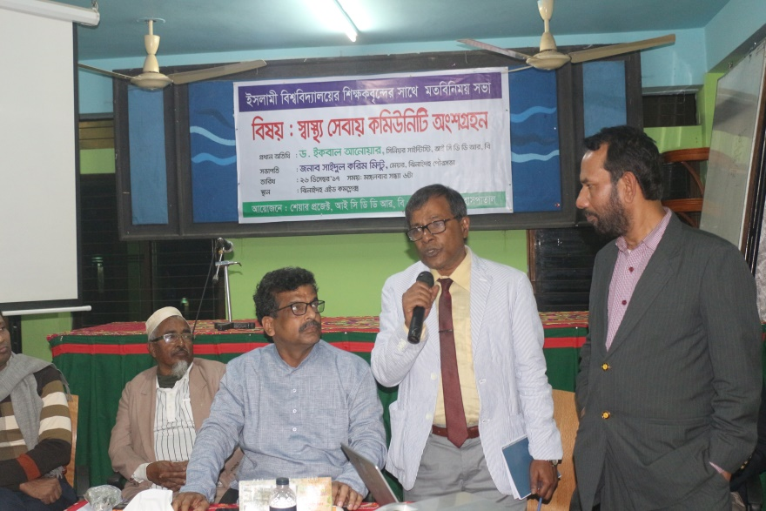
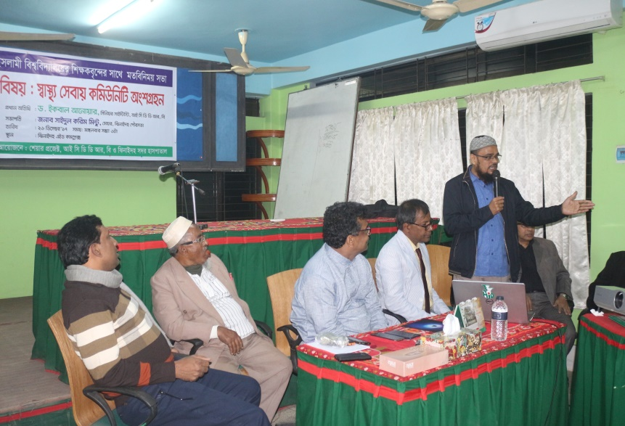
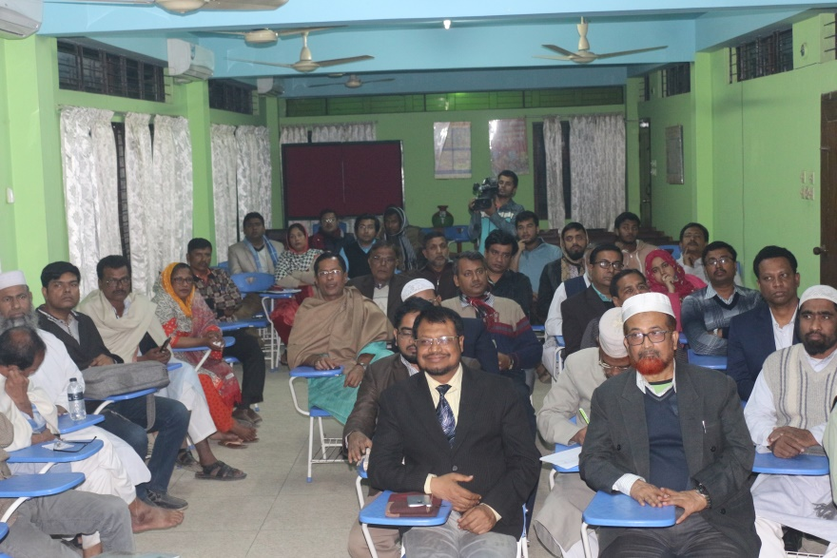
Meeting with the university teachers of IU on community participation

Slide 32




Improved pediatric word by local initiative

Slide 33



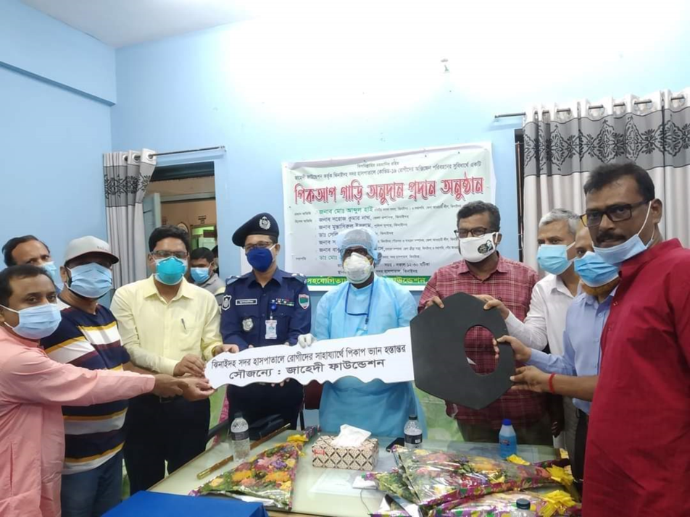
Community support in COVID -19 Management-1

Slide 34
Community support in COVID -19 Management-2
Central oxygen system - 1
High flow nasal cannula - 5
Oxygen concentrator - 3
Large oxygen cylinder - 48
C-PAP machine - 1
Pick-up caverd van - 1
Value – Nearly 52 Lac taka
Source of Donation
Prime minister’s relief fund.
MP, Jhenaidah-2.
Mayor, Jhenaidah pourosova.
Jaheedi Foundation.
Navana group.

Slide 35
Achievement of the Hospital
1. Active Community Participation in health service is an example in Bangladesh.
2. Improved performance of all services.
3. Improved Cleanliness and Beautification of Campus.
4.. The hospital is awarded 6 times from 2013 to 2018.
5. Improved Security.
6. Improved Financial Management
7. Replication of C- J Model by DGHS in 20 District hospital & 40 UHC of the country.
8. Nearly 45 lacs Taka support for 6 high flow oxygen nasal cannula, central oxygen supplying system for covid -19. patient

Slide 36
Lessons learned
Public health and hospital services and resources are inadequate vis-à-vis the need specially for the poor
This gap can be minimized through local participation.
Effective health service and hospital management require local support and participation.
Health personnel, specially the local health manager should take the role of catalyst
Local support can be attracted through improved services, and visible efforts and morality of the health managers
MOHFW can take initiative to roll out the model and the message
Jhenaidah-Chowgacha team will happy to volunteer

Slide 37

Thank You
আমাদের বাগানের ফুল
Notes:
37

